Slide 1

Department of Computer Science & Engineering Artificial Intelligence & Machine Learning A.P. Shah Institute of Technology G.B.Road,Kasarvadavli, Thane(W), Mumbai-400615 UNIVERSITY OF MUMBAI Academic Year 2023-2024

Slide 2
FORM AUTOMATION SYSTEM
Computer Science & Engineering
Artificial Intelligence and Machine Learning
By
Atul Gupta(21106006)
Kapil Surve(21106018)
Nishant Hire(21106060)
Shipra Asthana(21106039)
Under the Guidance of
Prof. Shraddha Shinde

Slide 3
Index
Introduction
Objectives
Features
Literature survey
Block Diagram
Tools/Software, Languages used
Implementation
Conclusion
References

Slide 4
Introduction
In the realm of modern education and workforce management, accurate attendance tracking forms the cornerstone of efficiency and productivity.
Embracing the revolutionary capabilities of Optical Character Recognition (OCR), our Attendance OCR project aims to revolutionize attendance management systems by automating the process of recording and managing attendance in educational institutions and workplaces.
Through the fusion of cutting-edge AI and deep learning technologies, this transformative solution brings unparalleled accuracy, speed, and convenience to attendance tracking, eliminating the need for manual record-keeping and unlocking a new era of streamlined administrative processes.

Slide 5
Objectives
To reduce and manage the data entry done by the staff.
To make the responsibility of teachers lighter as they do not need to calculate the attendance percentage.
To keep a maintained record of students actually present in the class by avoiding the proxy rates.
To automate the manual system.
To easily maintain higher priority task in institution.

Slide 6
Features
Precise Form Data Recording: Our OCR-powered system offers unrivaled accuracy in recognizing and recording attendance data, virtually eliminating errors associated with traditional manual methods.
Automated Data Integration: By integrating with existing form management platforms, our OCR solution automates data entry processes, reducing administrative burden and improving data integrity.
Customizable Reporting: Generate comprehensive form reports with ease, providing valuable insights for educators, administrators, and HR personnel to make informed decisions.
Real-time Data Processing: Harnessing the speed of OCR technology, our system enables real-time form data extraction, facilitating immediate availability of form records for stakeholders.

Slide 7
Literature Survey

Slide 8
Sr. No | Title | Author Name | Description
1. | IAS- Intelligent Attendance System based on Windows Image Acquisition(WIA) ,Optical Character Recognition(OCR) and Windows Communication Foundation(WCF) Service (May 2013) | Chirag Patel, Maitri Chokshi, Dr. Atul Patel | Taking students attendance in the class and then posting it in the online attendance system is a quite time consuming process for the teachers. In this paper, we have presented a normal approach for posting the attendance in the online attendance system without human intervention[1].
2. | Vision Tracking and Optical Character Recognition for Augmented Reality based Attendance System (April 2020) | D P Kaur, A Mantri | This paper presents a system for smart portable electronic device which is based on computer vision-based techniques for scanning the manually entered data by the user for automatic update on a central database and augmented reality is used for automatic display of updated data to the user. The developed application is in the form of an Android app which is installed in compatible smart portable electronic device[2].

Slide 9
Sr. No | Title | Author Name | Description
3. | OCR in Indian Scripts: A Survey (Nov 2015) | Peeta Basa Pati, A G Ramakrishnan | A significantly large number of scripts are used to represent these languages. A desire of vision researchers is to develop an integrated Optical Character Recognition (OCR) system which will be able to process all such scripts. Such a development, if objectified, will not only enable faster flow of information across the country, but also have a profound impact on its scientific and economic development[3].
4. | CONVERSION OF IMAGE TO EXCEL USING OCR TECHNIQUE (July 2022) | Amitha S, Mithun M, PC Chandana, Mayurjit Borkakoty, Adithya U | This paper proposes regarding the image processing of the text conversion and we use images in literacy education. In this research work, a web application is developed to convert the Attendance register image to excel conversion. It translates text just by capturing an image and uploading the image with system and conversion instantly appears on user’s system screen and can view the extracted text[4].

Slide 10
Sr. No | Title | Author Name | Description
5. | Automated Mobile Attendance System (AMAS) (March 2020) | Aditi Dankar, Poornima Panduranga Kundapur | One of the most common academic processes that institutions/universities follow is that of maintaining student/staff attendance. However, it has been observed that the conventional method of taking students attendance on registers to confirm their physical presence is still prevalent. In order to address the attendance issue, this paper proposes a simple user-friendly mobile application “Automated Mobile Attendance System” (AMAS). AMAS is interfaced with a website in the backend for data entry and report generation[5].

Slide 11
BLOCK DIAGRAM

Slide 12
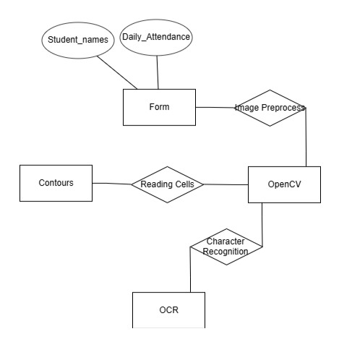

Slide 13



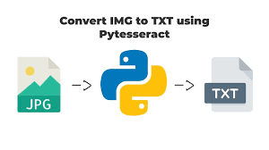







Tools/software, Languages used
OpenCV
PIL (Python Imaging Library)
Tesseract OCR
pytesseract
TensorFlow or PyTorch
Scikit-learn
Flask or Django
HTML, CSS, JavaScript
Django

Slide 14
PROJECT WORK

Slide 15
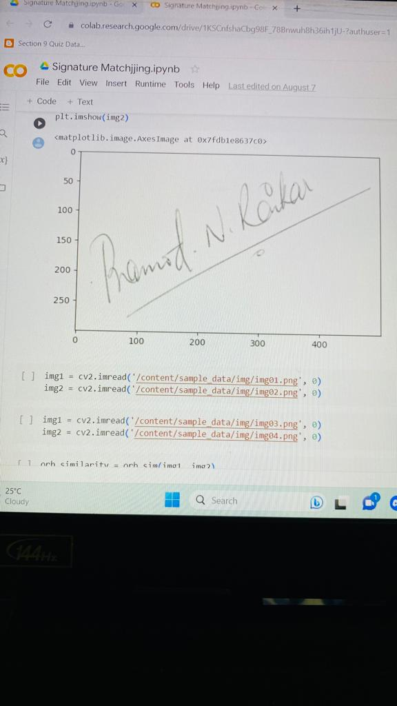
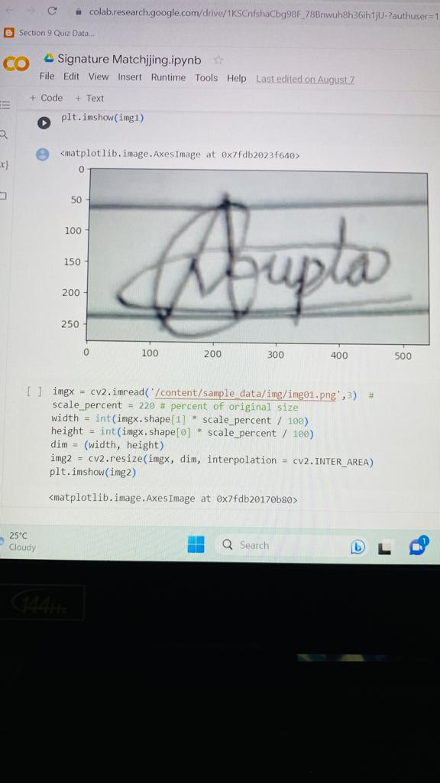
Implementation

Slide 16
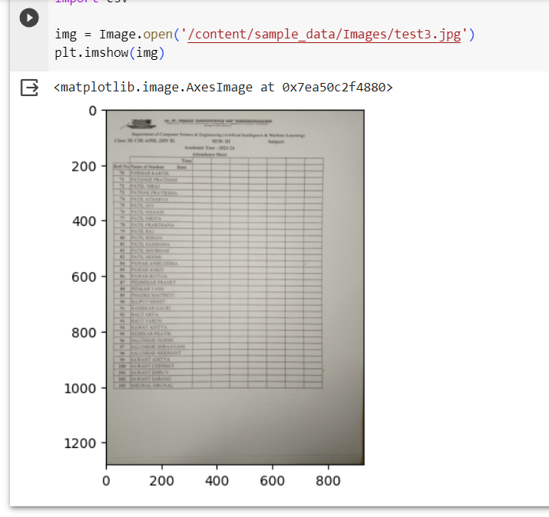
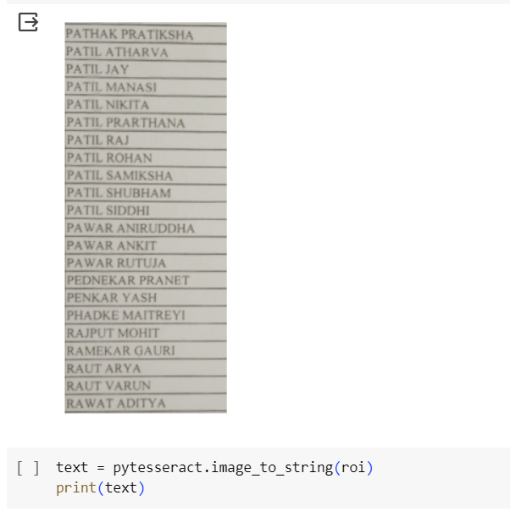
Implementation

Slide 17
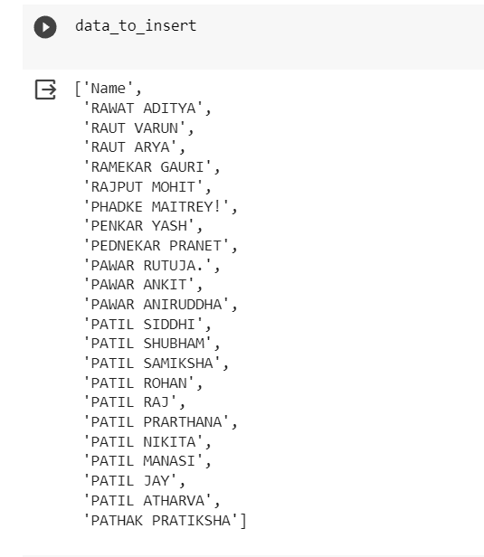
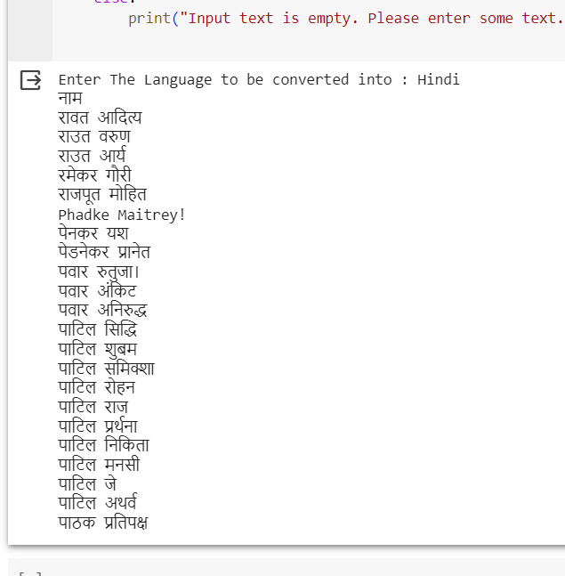
Implementation

Slide 18
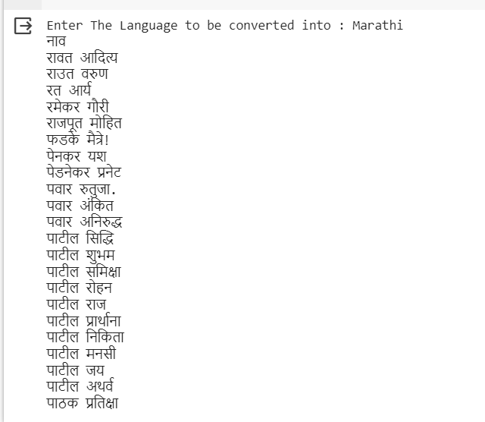
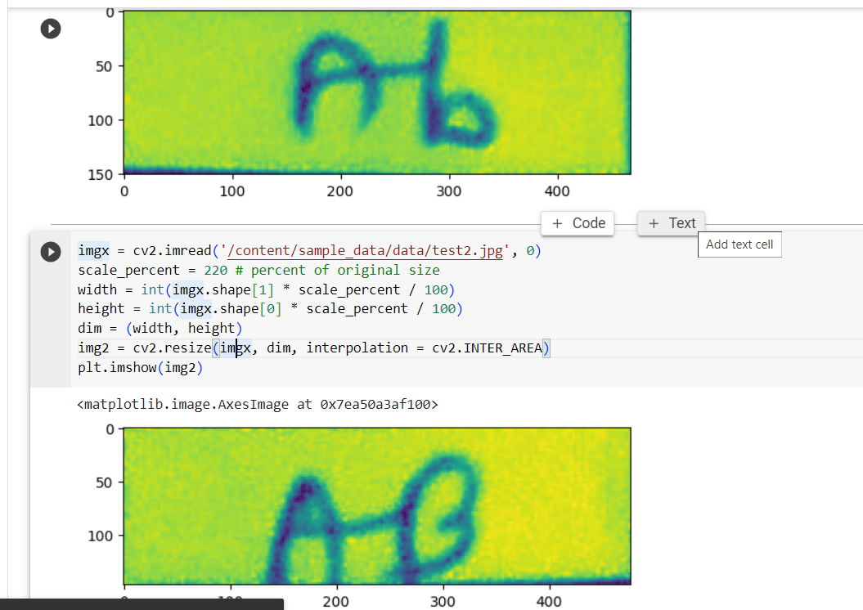
Implementation

Slide 19
Conclusion
The main conclusion of the OCR Attendance System is to keep present/absent details of employees or students by avoiding proxy system.
The benefit of implementing such a system is that the efficiency and accuracy of the data entered is easy to maintain.
This system saves valuable time and the resources by converting the data entered into excel sheet which makes it easy for calculating attendance percentage.

Slide 20
References
Journal Papers :
[1] Chirag Patel, Maitri Chokshi, Dr. Atul Patel, “IAS- Intelligent Attendance System based on Windows Image Acquisition(WIA) ,Optical Character Recognition(OCR) and Windows Communication Foundation(WCF) Service”, International Journal of Scientific & Engineering Research, ISSN 2229-5518, Volume 4, Issue 5, May-2013.
[2] D P Kaur, A Mantri, “Vision Tracking and Optical Character Recognition for Augmented Reality based Attendance System”, IOP Conference Series: Materials Science and Engineering, Volume 993, International Conference on Mechanical, Electronics and Computer Engineering, April 2020.
[3] Peeta Basa Pati, A G Ramakrishnan, “OCR in Indian Scripts : A Survey”, IETE Technical Review, Volume 22, 2005 - Issue 3, November-2015.
[4] Amitha S, Mithun M, PC Chandana, Mayurjit Borkakoty, Adithya U, “CONVERSION OF IMAGE TO EXCELUSING OCR TECHNIQUE”, International Research Journal of Modernization in Engineering Technology and Science, e-ISSN: 2582-5208, Volume:04, Issue:07, July 2022.
[5] Aditi Dankar, Poornima Panduranga Kundapur, “Automated Mobile Attendance System (AMAS)”, International Conference on Advances in Computing, Communication and Control (ICAC3), IEEE Xplore, March 2020.
Useful Links :
[6] https://youtu.be/dMaNiabqVdo?si=n-b62uOvtpxoxz6F
[7] https://youtu.be/PY_N1XdFp4w?si=mSHsvR5sbb16Ck9V
[8] https://youtu.be/rHux0gMZ3Eg?si=L6mwAZiJi7wRnwc3

Slide 21
THANK YOU

